Slide 1

TOR NETWORKS
SARMAD BASHIR
MUHAMMAD HAMAD

Slide 2
Privacy Enhancing Techniques
Proxy
Collect requests from clients
VPN
Extends a private network across a public network
Encrypted but single point of failure
DNS Bypassing
If domain is blacklisted DNS will not give you an IP
Change the DNS to a different and untampered one
Forwards request to the destination
Notes:
Proxy
A computer service which collect access requests from clients and forwards them to the destination on behalf of the requestors.
Proxies used for internet filtering and bypassing such internet filtering attempts.
VPN
network tunneling, is a way to channel all or part of the network traffic via a different middle node.
Private network and provides inter-connectivity to exchange information between various entities that belong to the VPN.
Encrypted communication but single point of failure
A virtual private network (VPN) extends a private network across a public network, such as the Internet. It enables users to send and receive data across shared or public networks as if their computing devices were directly connected to the private network.
VPNs may allow employees to securely access a corporate intranet while located outside the office. They are used to securely connect geographically separated offices of an organization, creating one cohesive network. Individual Internet users may secure their wireless transactions with a VPN, to circumvent geo-restrictions and censorship, or to connect to proxy servers for the purpose of protecting personal identity and location. However, some Internet sites block access to known VPN technology to prevent the circumvention of their geo-restrictions.
When it comes to filtering, DNS is another option for enforcing censorship. Since the initial step is to learn the IP address of the target service, a DNS server can be configured to block access to that service. If a specific domain name is black-listed, DNS would simply block access to that web site by not answering the DNS request. It is also possible to configure DNS to return a different IP address for a specific query, which would result ending up on a totally different web site.

Slide 3

The ONION Routing
Onion routing is an anonymous communication technique over a computer network
Constant encryption of messages
Encrypted messages are sent through several network nodes called onion routers which creates a circuit of nodes.
Notes:
TOR stands for “The Onion Router”
Onion routing is an anonymous communication technique over a computer network. Messages are constantly encrypted and then sent through several network nodes called onion routers which creates a circuit of nodes.

Slide 4
Brief History
Developed in mid 1990’s by US navy to protect U.S. intelligence communications online
Onion routing was further developed by DARPA in 1997
The public release was on 13th Aug,2004 as the “TOR: The Second Generation Onion Router”.
Notes:
The core principle of Tor, "onion routing", was developed in the mid-1990s by US Naval Research Laboratory with the purpose of protecting U.S. intelligence communications online.
Onion routing was further developed by DARPA in 1997
The public release was on 13th Aug,2004 as the “TOR: The Second Generation Onion Router”.

Slide 5
Working Of TOR
It creates a private network pathway, a circuit.
Starting with the end user, the network packets follow different hops, called relays, until the final hop of the circuit, the exit relay.
Exit relays will then transmit the request to the destination (e.g. the web site which the user wants to browse).
All connections between the first relay and the exit relay are encrypted
Each relay along the way knows only the previous and the next hop. No one knows the complete pathway in this architecture, except attacks which reveal some of them
Notes:
Regular Internet Connection VS TOR Network
Starting with the end user, the network packets follow different hops, called relays, until the final hop of the circuit, the exit relay.
Exit relays will then transmit the request to the destination (e.g. the web site which the user wants to browse).
All connections between the first relay and the exit relay are encrypted
Each relay along the way knows only the previous and the next hop. No one knows the complete pathway in this architecture, except attacks which reveal some of them

Slide 6
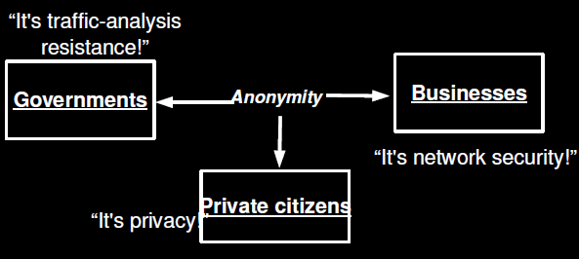
Need for anonymity ??

Slide 7
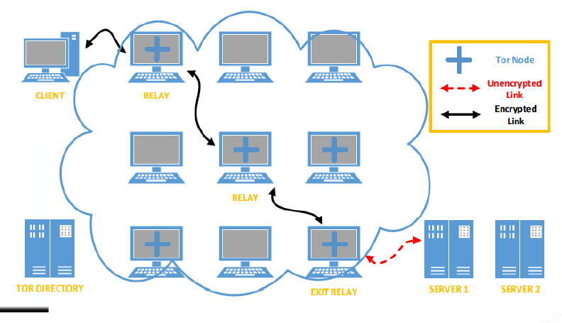
Architecture of TOR

Slide 8
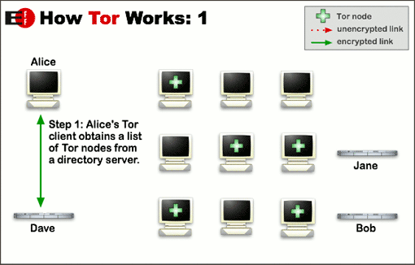
How TOR works ? : Step 1

Slide 9
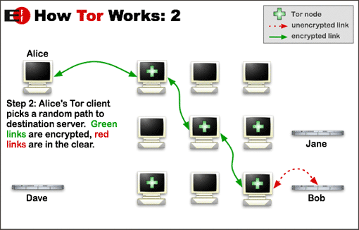
How TOR works ? : Step 2

Slide 10
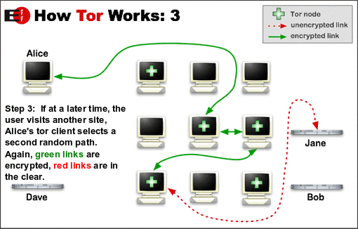
How TOR works ? : Step 3

Slide 11
Joining TOR as ????
Download TOR application and run it as …….
As a client
Connect TOR for your own use
Running a relay
Tor is not only technical but also a social network of volunteers who share network bandwidth with others
Using a Bridge
Bridges are unlisted, hidden relays which users can leverage as a first step to accessing Tor
Notes:
The second option is running a relay. Tor is not only technical but also a social network of volunteers who share network bandwidth with others. Running a regular relay, not an exit node, is a straightforward process. Debian/Ubuntu distributions of Linux have the necessary packages in Tor repositories.35 A Vidalia Relay Bundle does the same thing in Windows environments.3
Third option is running a bridge. Tor clients need to get a list of active relays in the network to start creating the circuit. Once established, the network flow will start from the first relay. But what if that relay, or even all relays in the circuit, are inaccessible to the user? This would simply make it impossible to join the network. This is a common technique for ISPs in Tor blocking countries.
Bridge relays, known as bridges in short, come into play at this stage. Bridges are unlisted, hidden relays which users can leverage as a first step to accessing Tor. Even if an ISP is blocking all the relays, users can still connect to Tor with the help of bridges. There are different ways of learning a bridge’s IP address, such as sending an email to bridges@bridges.torproject.org with the line ‘get bridges’ in the email body. An automatic reply will send 3 IP addresses to the sender, instantly.

Slide 12
Cells
Communication between relays in fixed-size cells.
Each cell is of 512 bytes.
On the basis of their commands they will be either called as control or relay cells
Notes:
Communication between relays in fixed-size cells. 512 bytes. On the basis of their commands either control or relay cells
Control cells
The header includes a circuit identifier (circID) that specifies which circuit the cell refers to and a command to describe what to do with the cell’s payload
.
Always interpreted by the node that receives them.
The control cell commands are: padding (currently used for keep alive but also usable for link padding); create or created (used to set up a new circuit); and destroy (to tear down a circuit).

Slide 13
Control Cells : Relay Cells
Control Cells
Header consists of cricID , CMD , and payload
CIRCID : Circuit identifier
Relay Cells
Additional header containing a streamID and end to end checksum
Payload : Actual data
CMD : command
Relay cells carry end to end stream data.
Commands are: Relay begin, Relay extended, Relay sendme, relay teardown
Notes:
Control cells
The header includes a circuit identifier (circID) that specifies which circuit the cell refers to and a command to describe what to do with the cell’s payload
.
Always interpreted by the node that receives them.
The control cell commands are: padding (currently used for keep alive but also usable for link padding); create or created (used to set up a new circuit); and destroy (to tear down a circuit).
Relay Cells
Additional header containing a streamID
End to end checksum
Relay cells carry end to end stream data.
Commands are: Relay begin, Relay extended, Relay sendme, relay teardown

Slide 14
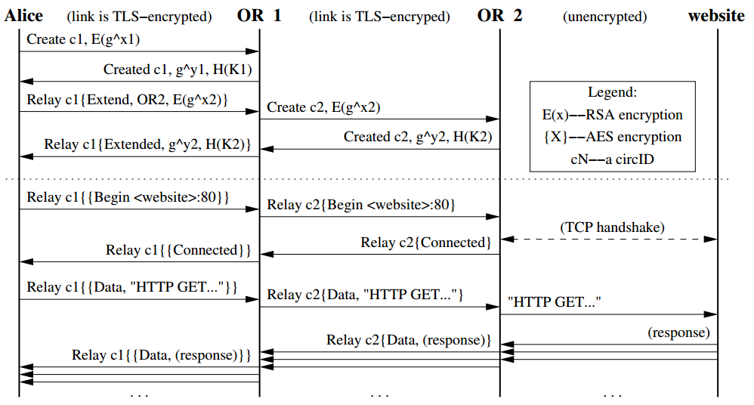
Constructing a Circuit
Notes:
Communication between relays in fixed-size cells. 512 bytes. On the basis of their commands either control or relay cells
Control cells
The header includes a circuit identifier (circID) that specifies which circuit the cell refers to and a command to describe what to do with the cell’s payload
.
Always interpreted by the node that receives them.
The control cell commands are: padding (currently used for keep alive but also usable for link padding); create or created (used to set up a new circuit); and destroy (to tear down a circuit).

Slide 15
Example
Let onion routers 4, 3, and 5 be randomly selected by the onion proxy
Notes:
Communication between relays in fixed-size cells. 512 bytes. On the basis of their commands either control or relay cells
Control cells
The header includes a circuit identifier (circID) that specifies which circuit the cell refers to and a command to describe what to do with the cell’s payload
.
Always interpreted by the node that receives them.
The control cell commands are: padding (currently used for keep alive but also usable for link padding); create or created (used to set up a new circuit); and destroy (to tear down a circuit).

Slide 16
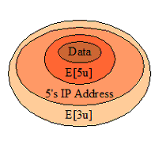
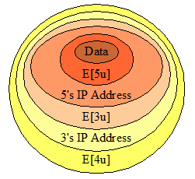
Onion Sent by Client to 4
Router 4 will decrypt the E{4u} layer using Its private key, to find the next router’s Ip address, and encrypted
Onion Sent by 4 to 3
Router 3 will decrypt the E{3u} layer using Its private key, to find the next router’s Ip address, and encrypted

Slide 17
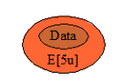
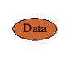
Onion Sent by 3 to 5
Router 5 will decrypt the E{5u} layer using Its private key, to just find unencrypted data packet
Data Sent by 5 to Target

Slide 18
Enhancement over previous version
Many TCP streams can share one circuit
Congestion Control
Directory Servers
End To End Integrity Checking
Hidden Services via Rendezvous Points
Notes:
Communication between relays in fixed-size cells. 512 bytes. On the basis of their commands either control or relay cells
Control cells
The header includes a circuit identifier (circID) that specifies which circuit the cell refers to and a command to describe what to do with the cell’s payload
.
Always interpreted by the node that receives them.
The control cell commands are: padding (currently used for keep alive but also usable for link padding); create or created (used to set up a new circuit); and destroy (to tear down a circuit).

Slide 19
Rendezvous Points and hidden services
Deploy a server on the Internet that anyone can connect to without knowing where it is or who runs it
Resistant to censorship, denial of service, physical attack
Network address of the server is hidden, thus can’t find the physical server
Notes:
Communication between relays in fixed-size cells. 512 bytes. On the basis of their commands either control or relay cells
Control cells
The header includes a circuit identifier (circID) that specifies which circuit the cell refers to and a command to describe what to do with the cell’s payload
.
Always interpreted by the node that receives them.
The control cell commands are: padding (currently used for keep alive but also usable for link padding); create or created (used to set up a new circuit); and destroy (to tear down a circuit).

Slide 20
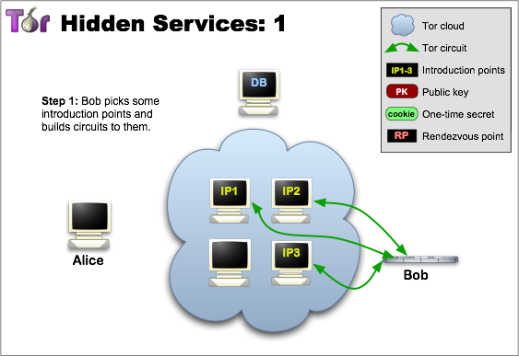
Hidden service : Step 1
Notes:
Communication between relays in fixed-size cells. 512 bytes. On the basis of their commands either control or relay cells
Control cells
The header includes a circuit identifier (circID) that specifies which circuit the cell refers to and a command to describe what to do with the cell’s payload
.
Always interpreted by the node that receives them.
The control cell commands are: padding (currently used for keep alive but also usable for link padding); create or created (used to set up a new circuit); and destroy (to tear down a circuit).

Slide 21
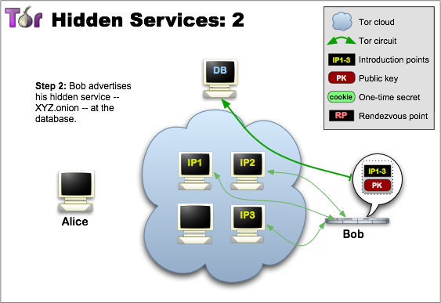
Hidden service : Step 2
Notes:
Communication between relays in fixed-size cells. 512 bytes. On the basis of their commands either control or relay cells
Control cells
The header includes a circuit identifier (circID) that specifies which circuit the cell refers to and a command to describe what to do with the cell’s payload
.
Always interpreted by the node that receives them.
The control cell commands are: padding (currently used for keep alive but also usable for link padding); create or created (used to set up a new circuit); and destroy (to tear down a circuit).

Slide 22
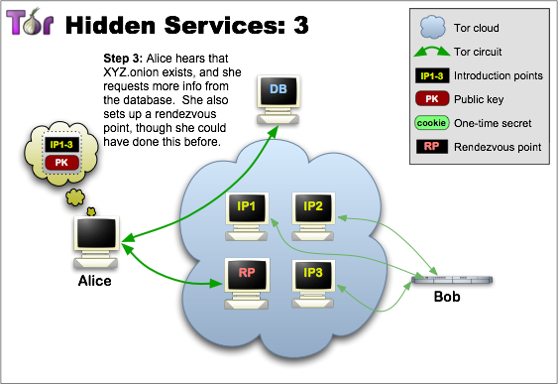
Hidden service : Step 3
Notes:
Communication between relays in fixed-size cells. 512 bytes. On the basis of their commands either control or relay cells
Control cells
The header includes a circuit identifier (circID) that specifies which circuit the cell refers to and a command to describe what to do with the cell’s payload
.
Always interpreted by the node that receives them.
The control cell commands are: padding (currently used for keep alive but also usable for link padding); create or created (used to set up a new circuit); and destroy (to tear down a circuit).

Slide 23
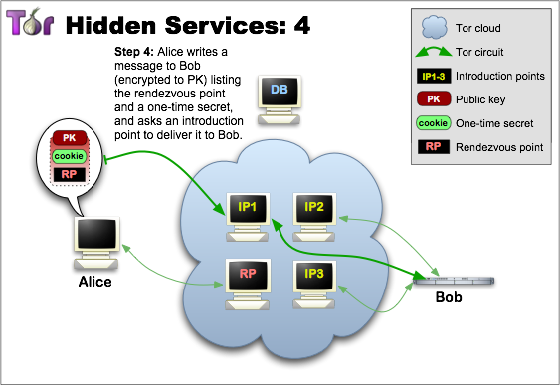
Hidden service : Step 4
Notes:
Communication between relays in fixed-size cells. 512 bytes. On the basis of their commands either control or relay cells
Control cells
The header includes a circuit identifier (circID) that specifies which circuit the cell refers to and a command to describe what to do with the cell’s payload
.
Always interpreted by the node that receives them.
The control cell commands are: padding (currently used for keep alive but also usable for link padding); create or created (used to set up a new circuit); and destroy (to tear down a circuit).

Slide 24
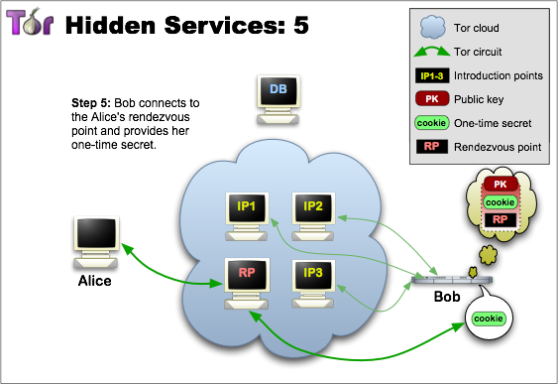
Hidden service : Step 5
Notes:
Communication between relays in fixed-size cells. 512 bytes. On the basis of their commands either control or relay cells
Control cells
The header includes a circuit identifier (circID) that specifies which circuit the cell refers to and a command to describe what to do with the cell’s payload
.
Always interpreted by the node that receives them.
The control cell commands are: padding (currently used for keep alive but also usable for link padding); create or created (used to set up a new circuit); and destroy (to tear down a circuit).

Slide 25
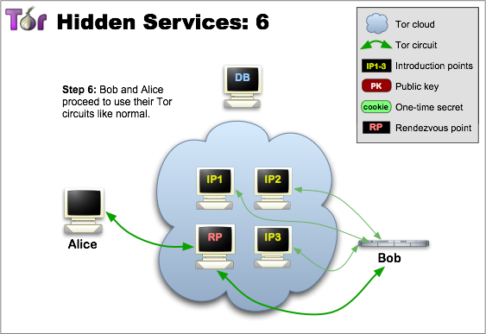
Hidden service : Step 6
Notes:
Communication between relays in fixed-size cells. 512 bytes. On the basis of their commands either control or relay cells
Control cells
The header includes a circuit identifier (circID) that specifies which circuit the cell refers to and a command to describe what to do with the cell’s payload
.
Always interpreted by the node that receives them.
The control cell commands are: padding (currently used for keep alive but also usable for link padding); create or created (used to set up a new circuit); and destroy (to tear down a circuit).

Slide 26

“ DEEP & DARK WEB ”
When it’s dark enough ,you can see the stars …..
Ralph Waldo Emerson
Notes:
Communication between relays in fixed-size cells. 512 bytes. On the basis of their commands either control or relay cells
Control cells
The header includes a circuit identifier (circID) that specifies which circuit the cell refers to and a command to describe what to do with the cell’s payload
.
Always interpreted by the node that receives them.
The control cell commands are: padding (currently used for keep alive but also usable for link padding); create or created (used to set up a new circuit); and destroy (to tear down a circuit).

Slide 27
“ DEEP & DARK WEB ”
DEEP WEB
This is a sub-set of the internet that can not be indexed (found) by search engines like Google.
DARK WEB
This is a sub-set of the Deep Web that contains all sorts of websites, both legal and illegal.
The types of sites include black markets that sell things like drugs, counterfeit goods, and weapons, you also have hacking sites, bitcoin tumbling, and even sites for hitmen.
Notes:
Communication between relays in fixed-size cells. 512 bytes. On the basis of their commands either control or relay cells
Control cells
The header includes a circuit identifier (circID) that specifies which circuit the cell refers to and a command to describe what to do with the cell’s payload
.
Always interpreted by the node that receives them.
The control cell commands are: padding (currently used for keep alive but also usable for link padding); create or created (used to set up a new circuit); and destroy (to tear down a circuit).

Slide 28
Darknet websites are accessible only through networks such as Tor ("The Onion Router”)
Tor-accessible sites are widely used among the Darknet users and can be identified by the domain “.onion
While Tor focuses on providing anonymous access to the Internet, I2P specializes on allowing anonymous hosting of websites.
Identities and locations of Darknet users stay anonymous and cannot be tracked due to the layered encryption system.
Notes:
Darknet websites are accessible only through networks such as Tor ("The Onion Router”) and I2P (“Invisible Internet Project”).^{[17]} Tor browser and Tor-accessible sites are widely used among the darknet users and can be identified by the domain “.onion”.^{[18]} While Tor focuses on providing anonymous access to the Internet, I2P specializes on allowing anonymous hosting of websites.^{[19]} Identities and locations of darknet users stay anonymous and cannot be tracked due to the layered encryption system. The darknet encryption technology routes users’ data through a large number of intermediate servers, which protects the users’ identity and guarantees anonymity. The transmitted information can be decrypted only by a subsequent node in the scheme, which leads to the exit node. The complicated system makes it almost impossible to reproduce the node path and decrypt the information layer by layer.^{[20]} Due to the high level of encryption, websites are not able to track geolocation and IP of their users as well as the users are not able to get this information about the host. Thus, communication between darknet users is highly encrypted allowing users to talk, blog, and share files confidentially.^{[21]}
The darknet is also used for illegal activity such as illegal trade, forums, and media exchange for pedophiles and terrorists.^{[22]}
At the same time, some of the traditional websites create alternative accessibility for the Tor browser in efforts to connect with their users. Such that ProPublica newspaper launched a new version of its website available for Tor users.^{[23]}

Slide 29


Slide 30
Arrest and trial of Ross Ulbricht
Founder and owner of Silk Road
He was arrested on 2 October 2013 in San Francisco
Charges of money laundering, computer hacking, conspiracy to traffic narcotics, and attempting to have six people killed.
26,000 bitcoins from accounts on Silk Road, worth approximately $3.6 million
144,342 bitcoins were kept which had been found on Ulbricht's computer, roughly $87 million.
He faced 30 years to life in prison
Notes:
Communication between relays in fixed-size cells. 512 bytes. On the basis of their commands either control or relay cells
Control cells
The header includes a circuit identifier (circID) that specifies which circuit the cell refers to and a command to describe what to do with the cell’s payload
.
Always interpreted by the node that receives them.
The control cell commands are: padding (currently used for keep alive but also usable for link padding); create or created (used to set up a new circuit); and destroy (to tear down a circuit).

Slide 31
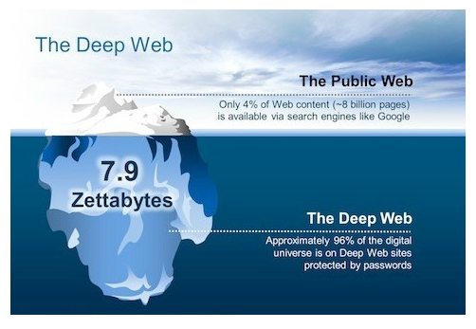

Slide 32
Attacks on TOR
Passive
Observing user traffic patterns.
Active
Compromise keys.
Observing user content.
End-to-end timing correlation.
Website fingerprinting.
Run a recipient
Tagging attacks.
Replace contents of unauthenticated protocols.

Slide 33


